Slide 1
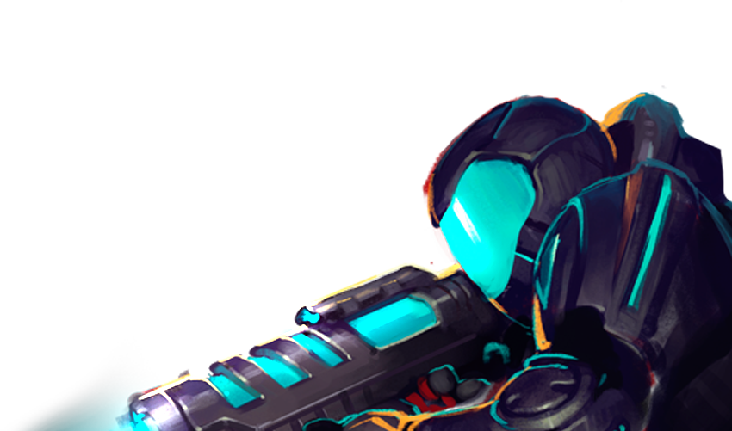
STARTING AND MAINTAINING AN
INDIE BUSINESS
Matt Raithel |
@raitheoshow
@graphitelab
more info in the notes section…
Notes:
…like this one! Thanks for reading. Share and post or email me at matt.raithel@graphitelab.com!
Want to learn more? Hit us up on twitter or sign up for our mailing list! You can find the signup at the bottom of this page: http://graphitelab.com/about-us/
Read more about indie dev here: http://graphitelab.com/labnotes/

Slide 2
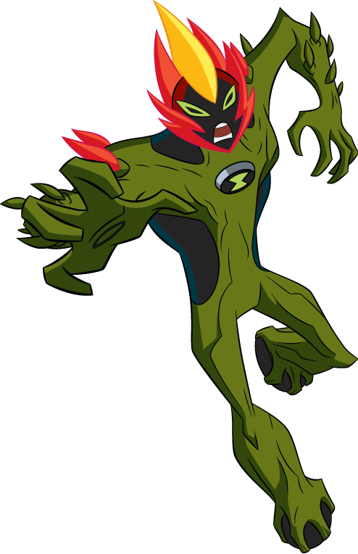
(WHO)TF IS MATT RAITHEL?
Started Game Dev in 2004 as a 3D artist with Black Lantern Studios.
Art Director, Director of Art and Design, Vice President of Operations, Studio Head.
Career built on work for Nickelodeon, Disney, Hasbro, Activision, WB and more.
Notes:
DSI Games was the first repeat client at Black Lantern. We did 10+ titles with them over a 5 year period.
Nickelodeon and Hasbro have both been repeat clients as well each with 5+ projects over 5 years.

Slide 3
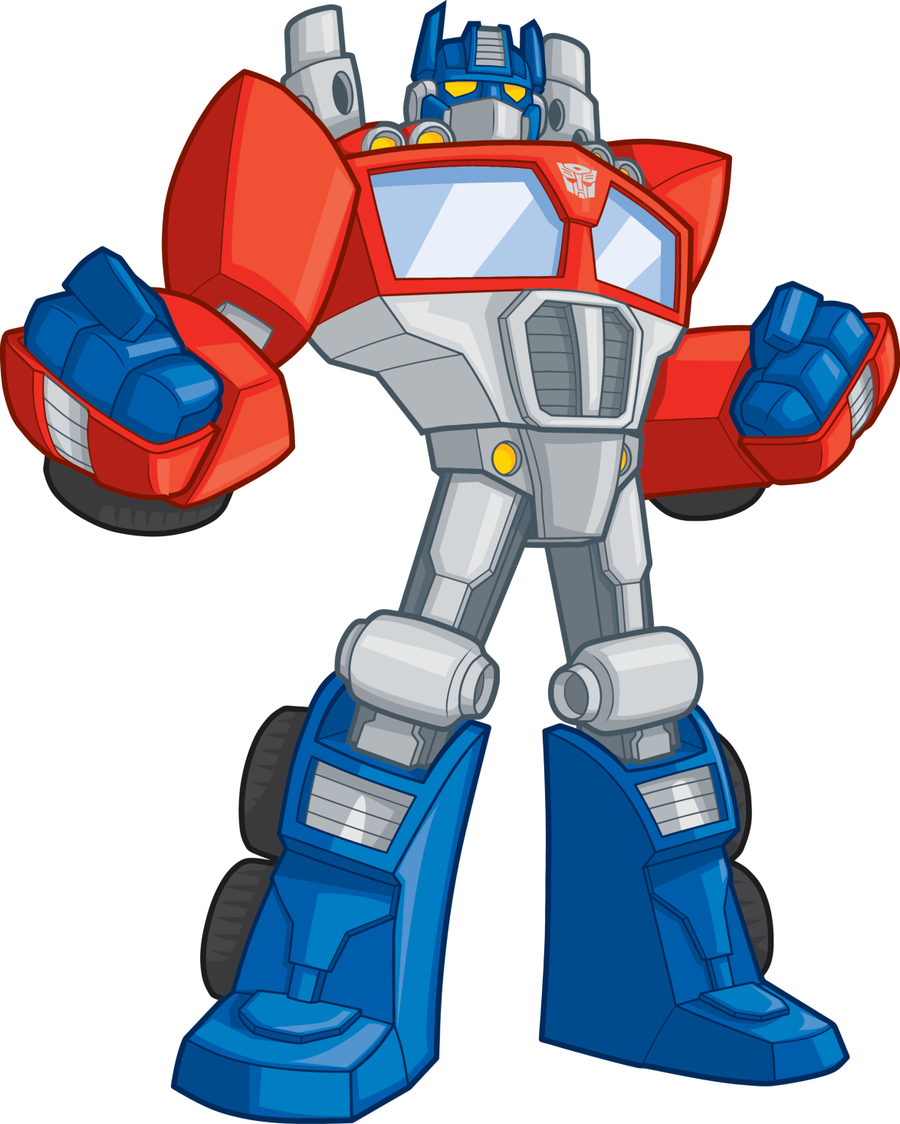
(WHO)TF IS MATT RAITHEL?
Over 30 retail releases with another 30+ as digital download (only two are OIP)
Managed teams from 1 – 50+ people and budgets from $10,000 to $1,000,000+
Founder and Studio Director of Graphite Lab (f. 2009) Instructor of Game Design, Maryville University (2015)
Notes:
The two OIPs are SOL EXODUS, HIVE JUMP.

Slide 4
(WHO)TF IS GRAPHITE LAB?
Game developer with unique experience developing kids entertainment brands
Over 20 years combined game development experience dating back to the Game Boy Advance
20+ Employees in our company network located in St. Louis, MO, USA
Since January 1, 2014, our apps have been loaded over 30,000,000 times
Notes:
My first title on the Game Boy Advance was called Board Game Classics.

Slide 5
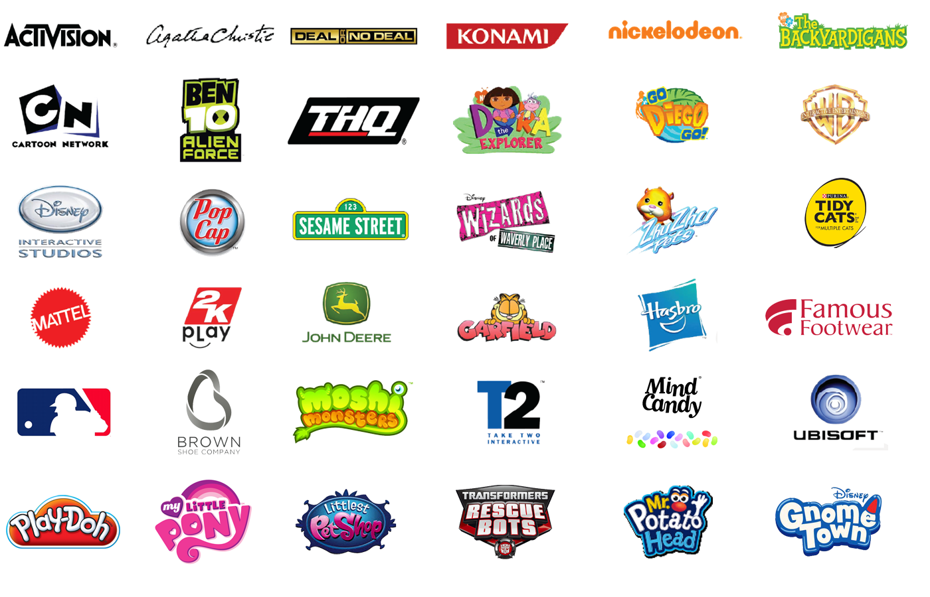
Notes:
We’ve done work for these fine folks!

Slide 6
CASH
PEOPLE
RELATIONSHIPS
Notes:
What every business needs to stay alive.
CPR… get it?!

Slide 7
CASH You need cash to operate
Where it comes from
Development Revenue
Royalties
Product Sales
Where it goes
Rent ($8.00-15.00 Sq ft in St Louis)
Software ($125)
Quickbooks ($125 -$300/mo)
Internet Connection ($40 - $400)
Computers ($800/person +)
Supplies ($50/mo +)
PEOPLE (Priceless)
CASH
Notes:
We get about 80% of our revenue from development advances.
10% from product sales
And 10% from royalties.

Slide 8
HOW WE DID IT.
Month 1 – 3: Built up 3 months of cash (some borrowed from family).
Month 4 – 6: Became a Contractor. Hired other Contractors. Use the saved cash to survive.
Month 6 -12: Focused efforts on fewer things.
Years later: Bank involvement – usually only interested with a previous relationship and a notable opportunity.
ALSO
Kickstarter – 300-500 hours investment. More about OIP or Product.
GOAL: 20% profit year over year.
CASH
Notes:
You have to bring your own skin to the game if you are coming from nothing.
Work on other games. You may start early by taking on every job you can. We made Blackberry Apps. We made Websites. We did a lot of different things while building our team for eventual “games” focus.

Slide 9
PEOPLE THE RIGHT PEOPLE MAKE ALL THE DIFFERENCE
Who works here
Artists
Programmers
Game Designers
Testers
Production Manager
Interns
Starting a Game Biz? Cover core disciplines with your founding (or at least managing group): Production, Programming, Art, Game Design.
Network and meet people.
Hire who you know and respect.
Hire them for small jobs and bring them on to help (trials).
PEOPLE
Notes:
Find our more about our team at http://graphitelab.com/about-us/

Slide 10
HOW WE DID IT.
Month 1 – 3: Founding Partnership (Art, Programming, Design)
Month 4 – 12: Begin 1st Project.
Contract if you can. With the second and third projects, bring on people to help with small parts.
GOAL: A business that can operate without you.
PEOPLE
Notes:
Read the E-Myth. It will explain everything.

Slide 11
RELATIONSHIPS WITHOUT THEM YOU WON’T SURVIVE
Our strongest relationships
DSI Games
Nickelodeon
Hasbro
Build a portfolio through friends (contract) jams (polish those jams).
Reach out through bizdev accounts. Usually find these on media pages.
Conferences: GDC, Casual Connect, Lic Expo.
Stay connected.
RELATIONSHIPS
Notes:
Find out how long it takes to get your sales. This is important in planning for the next one!
Our Sales process doesn’t end with the signing of a contract, or even the completion of the project. It ends with the signing of the Second project with the same client. We always are working hard on the first one so we’re worthy of the second!

Slide 12
HOW WE DID IT.
Month 1 -3: Build a demo of a project you would like to make. Share it with companies who make that type of project.
Scour the top 100 games and look at their credits. Who made them? Offer services. Over and over.
Go to GameStop and flip the boxes around. Who made them? Could you do the same?
Think of projects in threes. You get benefit on the third.
GOAL: Repeat opportunities.
RELATIONSHIPS
Notes:
Focus on a single type of development. We focused on kids storybooks. We used that to expand our skills.

Slide 13
CASH
PEOPLE
RELATIONSHIPS
CASH
PEOPLE
RELATIONSHIPS
CASH
PEOPLE
RELATIONSHIPS
Notes:
This is the cycle. Cash, then people then relationships… hopefully to earn more cash, to invest further in the people who will create more meaningful relationships… and on it goes.

Slide 14
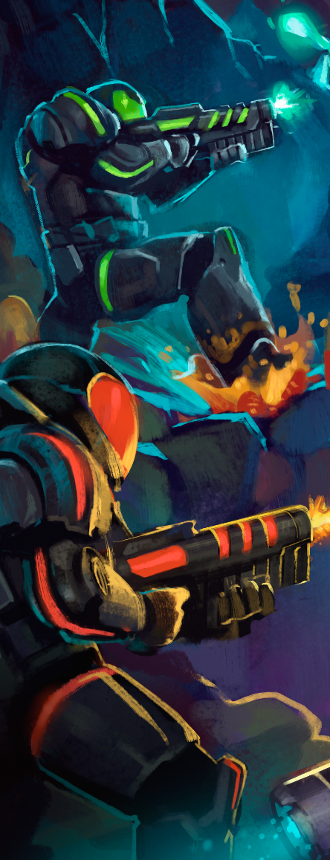
HOW DO WE MAINTAIN?
Maintenance is learning and adapting.
Monthly Reviews. Track progress.
Quarterly reviews. Make changes. Make Goals.
Find out how long it takes to get your sales!!!
FIND OUT WHAT TYPE OF YEAR YOU GET THEM TOO!!!
Where are the advantages?
What don’t you need to focus on?
What excites your team? What excites you?

Slide 15
CHOOSE!
DORA
PINKIE PIE
Notes:
This was a game we played during the presentation. The audience picked what we talked about next.
I told stories about how we got these projects. Both of which I was like “eh” maybe we shouldn’t work on these. They turned out to both be 1.000.000 unit sellers and teach our team about interaction with a younger audience. These learnings were important for our company growth and development of our “kids expertise”.

Slide 16
CHOOSE!
IRON CHEF
SESAME STREET
Notes:
This was a game we played during the presentation. The audience picked what we talked about next.
I told stories about how both of these projects could have put our company out of business.

Slide 17
CHOOSE!
RABID FOX
HOWIE MANDEL
Notes:
This was a game we played during the presentation. The audience picked what we talked about next.
I talked about persistence. We had to press and press Konami to get Ben 10. We had to press our team to make Deal or No Deal the best it could be.

Slide 18
THANKS FOR PLAYING!
Matt Raithel |
@raitheoshow
@graphitelab
Notes:
Thanks for reading!
Want to learn more? Hit us up on twitter or sign up for our mailing list! You can find the signup at the bottom of this page: http://graphitelab.com/about-us/
Read more about indie dev here: http://graphitelab.com/labnotes/

